Slide 1


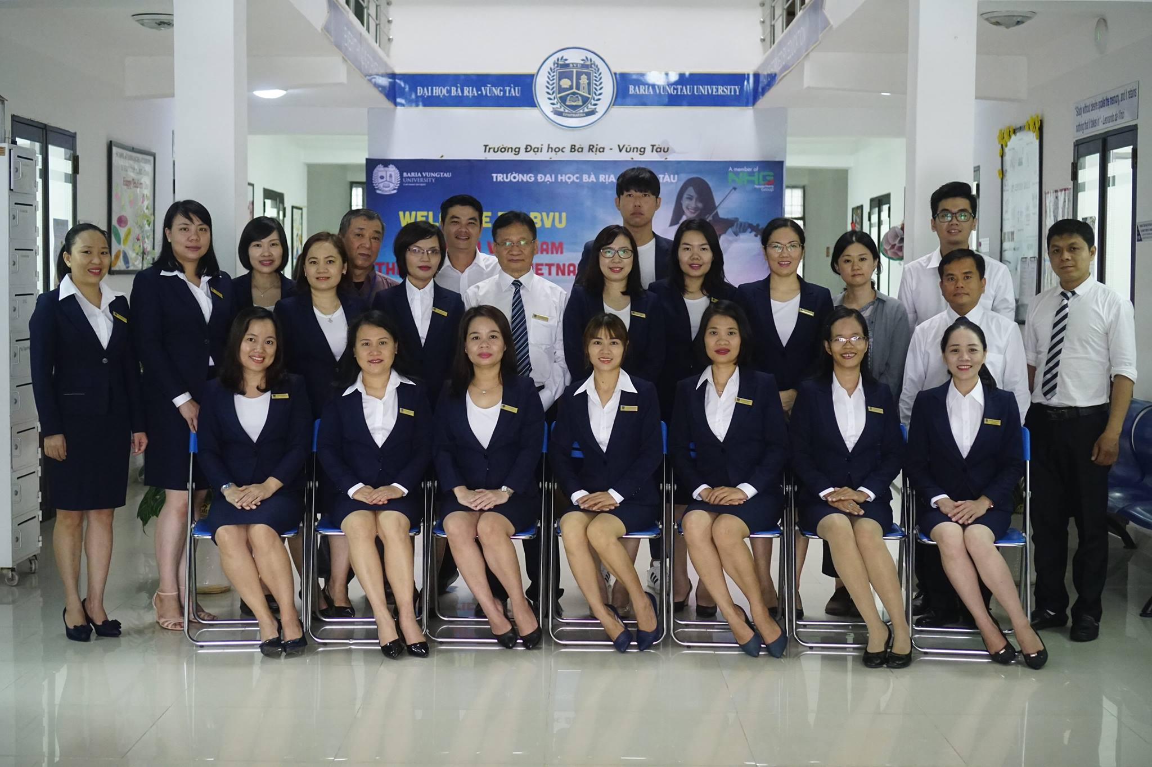

Slide 2

AMERICAN JETSTREAM PRE-INTERMEDIATE B

Slide 3
TEACHER’S PERSONAL INFORMATION
Name: Nguyen Thanh Loan
Facebook: Loan Nguyễn Thanh
Mobile number: 0942 255 937
Email: loannguyenthanh1978@gmail.com

Slide 4
REVIEW (unit 11 + 12)

Slide 5
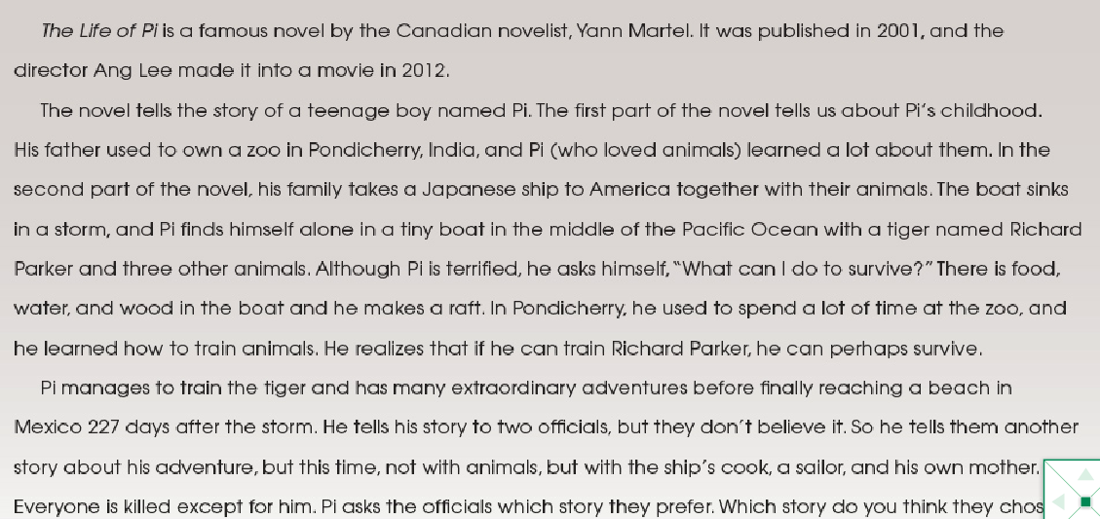

READING

Slide 6
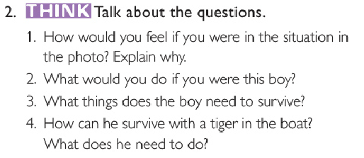

READING

Slide 7
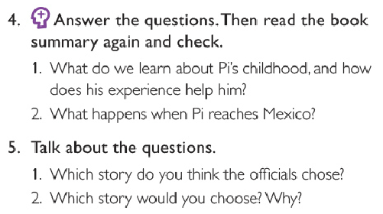

READING

Slide 8

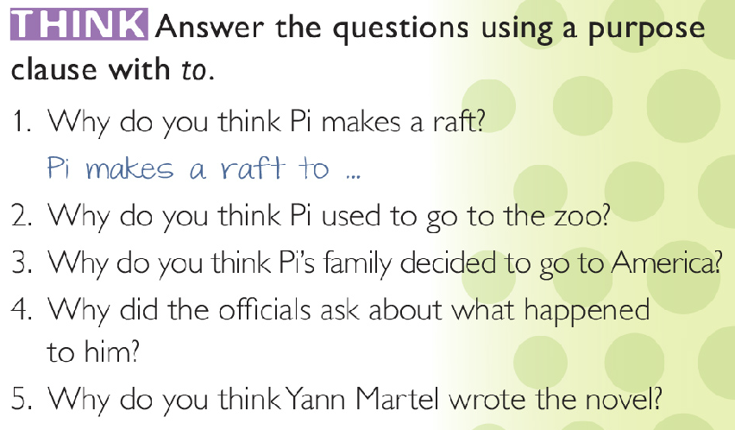
READING

Slide 9
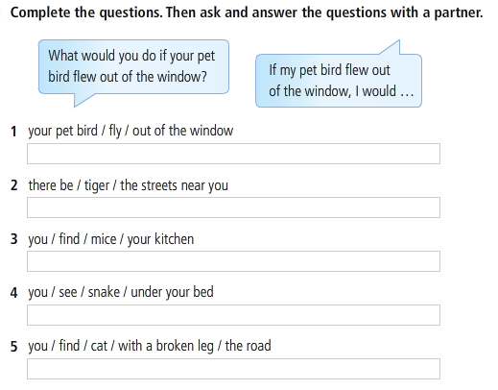
GRAMMAR

Slide 10
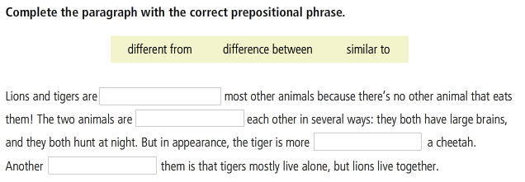


PREPOSITION PARK

Slide 11

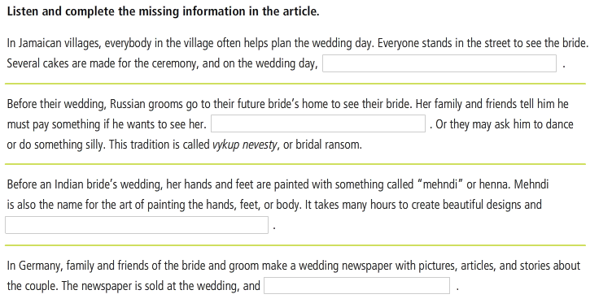
CROSS CULTURE
Wedding traditions

Slide 12
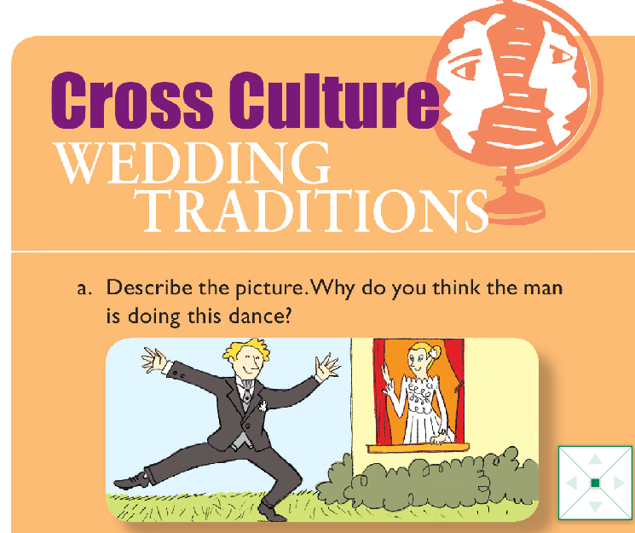

Slide 13
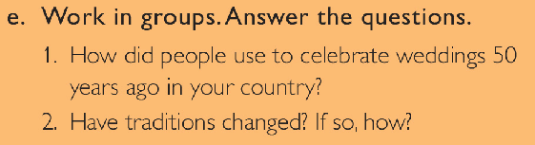
CROSS CULTURE
Wedding traditions

Slide 14
References
Life of Pi - summary
https://www.youtube.com/watch?v=LW9pTrFyhi8
Wedding traditions around the world
https://www.youtube.com/watch?v=6WeD_a0Zil4
https://www.youtube.com/watch?v=9w4AV1IpicI
Wedding traditions in Vietnam
https://www.youtube.com/watch?v=8RnqYh3ZYUE

